Slide 1

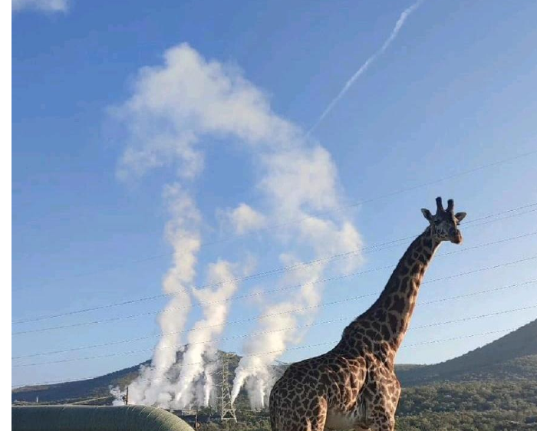
SPE AFRICA
GEOTHERMAL
WORKSHOP
Harnessing Africa’s Geothermal Potential for a Sustainable Energy Future
20–21 July 2026 | Fairmont The Norfolk Hotel | Nairobi, Kenya
TECHNICAL PRESENTATIONS

Slide 2

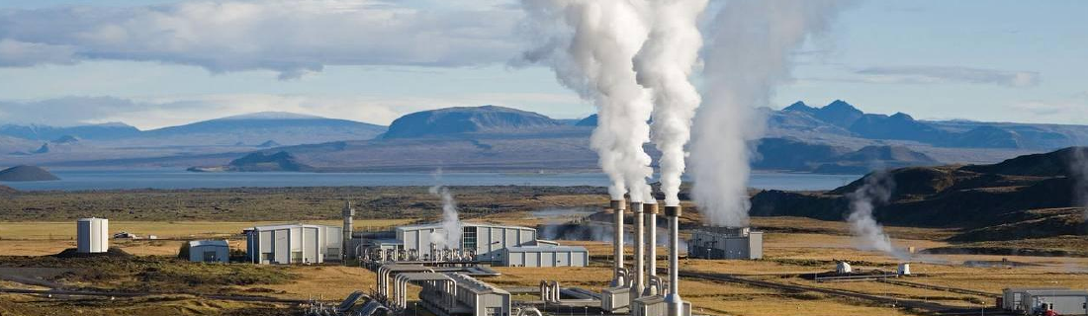
PRESENTATION TITLE
Title of Paper / Technical Talk Goes Here
SPE Africa Geothermal Workshop 2026
Presenter Name, Affiliation
Co-authors / Session name
20–21 July 2026 | Nairobi, Kenya
SPE Africa Geothermal Workshop 2026 | Nairobi, Kenya | 20–21 July 2026
02
02

Slide 3
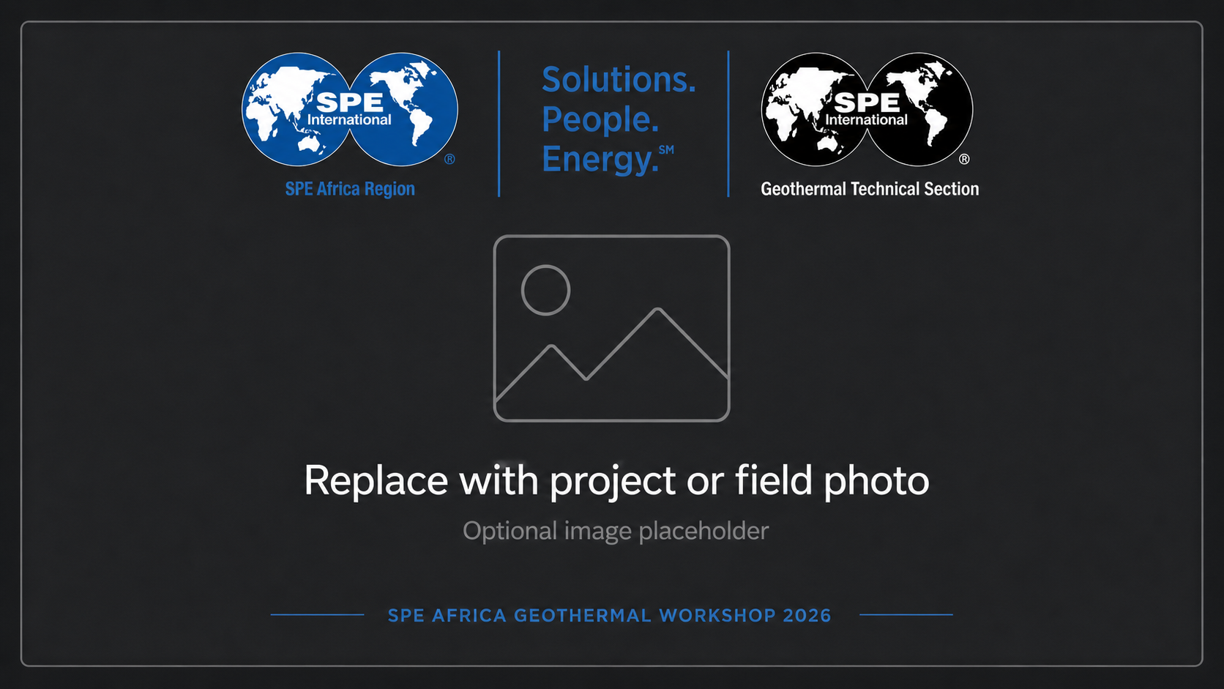
Presentation Roadmap
Use this slide to orient the audience before moving into technical detail.
01
Context & motivation
02
Methods / workflow
03
Results / findings
04
Implications for Africa
05
Recommendations / next steps
Caption and credit
SPE Africa Geothermal Workshop 2026 | Nairobi, Kenya | 20–21 July 2026
03
03

Slide 4
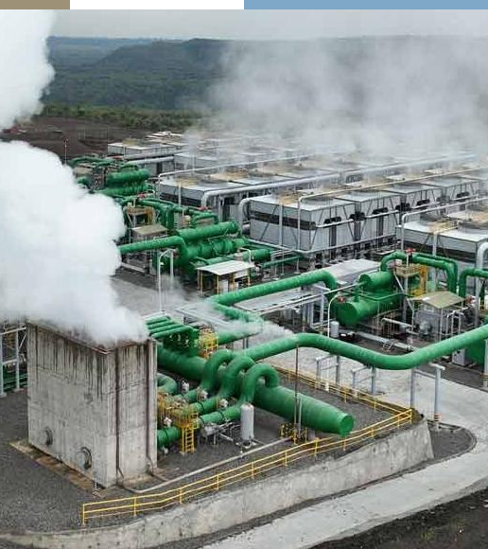
SECTION 01
Section Title Goes Here
Short subtitle that sets the context for the next segment.
SPE Africa Geothermal Workshop 2026

Slide 5
Why this topic matters
Connect the technical work to African geothermal deployment.
01
02
03
Problem
Approach
Impact
What technical or market barrier does your work address?
What method, dataset, technology, or workflow did you use?
How does this help policy, investment, exploration, drilling, direct-use, or scale-up?
SPE Africa Geothermal Workshop 2026 | Nairobi, Kenya | 20–21 July 2026
05
05

Slide 6
TECHNICAL PRESENTATION TEMPLATE
Technical Context / Literature Anchor
Keep the main message crisp;leave details for discussion or backup slides.
Key technical context or research question goes here.
Briefly state the gap in current practice, policy, finance, or technology.
Explain why the African context changes the problem or opportunity.
End with the core hypothesis or objective of the work.
Insert key figure, map, reservoir image, field photo, or conceptual diagram
Caption / source note: keep image credit short and readable.
SPE Africa Geothermal Workshop 2026 | Nairobi, Kenya | 20–21 July 2026
06
06

Slide 7
Methodology and Results
Use this layout to connect what you did with what you found.
METHOD / WORKFLOW
RESULTS / INTERPRETATION
Step 1: Data / field input
Step 2: Model / analysis method
Step 3: Validation / uncertainty check
Step 4: Decision or application
Result chart / table / cross-section
Key finding 1 with metric
Key finding 2 with uncertainty
Implication for development or investment
Workflow graphic / map / field layout
SPE Africa Geothermal Workshop 2026 | Nairobi, Kenya | 20–21 July 2026
07
07

Slide 8
Field case study / site visit / project photograph
Use this slide for one powerful image and one clear takeaway.
Caption / image credit
KEY TAKEAWAY
SPE Africa Geothermal Workshop 2026 | Nairobi, Kenya | 20–21 July 2026
08
08

Slide 9
Key Result or Metric
Designed for charts, comparative results, capacity forecasts, or cost curves.
Insert chart / graph / table
Keep axes readable from the back of the room.
INSIGHT
Write the conclusion, not only the data.
Example: “This workflow reduced uncertainty in early-stage prospect ranking and supports faster screening of geothermal targets.”
Recommendation / next action
SPE Africa Geothermal Workshop 2026 | Nairobi, Kenya | 20–21 July 2026
09
09

Slide 10
From Resource to Deployment
A layout for workflows, policy roadmaps, project phases, or technology maturation.
01
02
03
04
Explore
Derisk
Develop
Operate
Resource screening
Geology, geophysics, chemistry
Drilling strategy
Reservoir confirmation
Financing, EPC, permits
Workforce and supply chain
Monitoring, optimization
Direct-use / power / heat integration
SPE Africa Geothermal Workshop 2026 | Nairobi, Kenya | 20–21 July 2026
10
10

Slide 11
Paper Title / Main Finding
A structured layout for researchers presenting accepted work.
Research Question
Primary technical figure / map / simulation output
Key Numbers
State the specific technical question or problem in one sentence.
Metric 1
XX%
Method
Metric 2
Summarize data, tools, modelling, or field procedure.
XX MW
Metric 3
Conclusion
XX yrs
State the outcome and why it matters for Africa.
SPE Africa Geothermal Workshop 2026 | Nairobi, Kenya | 20–21 July 2026
11
11

Slide 12
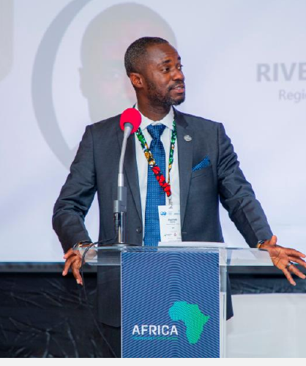
SPEAKER / PANELIST PROFILE
Speaker Name
Title / Organization / Country
Session / Presentation Title
Short professional background
Relevant expertise or project experience
One-line contribution to the workshop theme
Harnessing Africa’s Geothermal Potential
SPEAKER PHOTO
SPE Africa Geothermal Workshop 2026 | Nairobi, Kenya | 20–21 July 2026
12
12

Slide 13
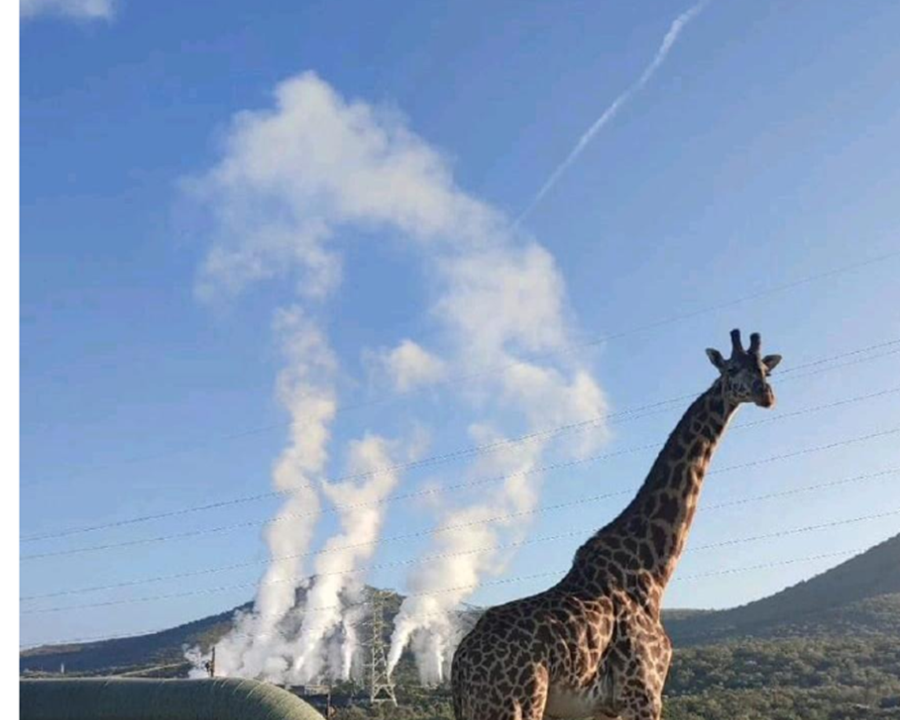
Thank you
Questions & Discussion
Presenter Name
Email | LinkedIn | Organization
SPE Africa Geothermal Workshop 2026
Nairobi, Kenya | 20–21 July 2026

Slide 14
TEMPLATE USAGE GUIDE
Template Layout Guide
Delete this slide before final submission if not needed.
Use slide 2 for paper or keynote title pages.
Use slide 3 for agenda / talk outline.
Use slide 4 as a section divider.
Use slides 5–11 for technical content, methods, results, charts, workflows, and case studies.
Use slide 12 for speaker introductions or panelist profiles.
Use slide 13 for closing / Q&A.
Style Guidance
Keep slide titles short.
Use no more than 3–5 bullets per slide.
Credit photos and external figures in small text below visuals.
Prefer field photos, maps, data charts, and diagrams over dense paragraphs.
Primary colors: SPE blue, deep blue, yellow, pale blue, white.
SPE Africa Geothermal Workshop 2026 | Nairobi, Kenya | 20–21 July 2026
14
14

